Slide 1

AWS FOR BEGINER

Slide 2
Agenda
Linux
Git
CI/CD
Docker
GLOBAL INFRA STRUCTURE CỦA AWS
EC2
Tổng kết

Slide 3

GLOBAL INFRASTRUCTURE CỦA AWS

Slide 4
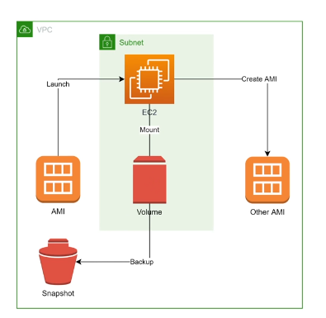
Khái niệm cơ bản của EC2: + AMI: + EBS volume: Giống như ổ cứng + Snapshot: là ảnh chụp của volume (không quan tâm volume EBS đang dung là bao nhiêu, volume 200GB dung 2 GB = >snapshot bằng 200GB) + Instance:
GLOBAL INFRASTRUCTURE CỦA AWS

Slide 5
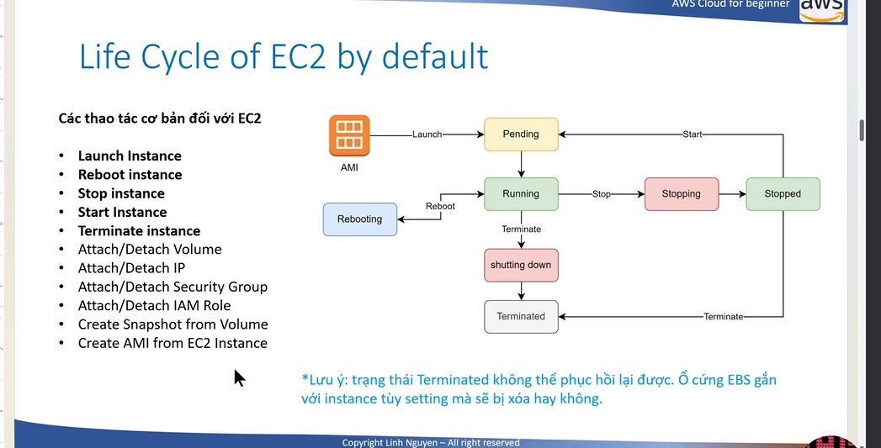
Vòng đời của một EC2 BY DEFAULT + launch instance + reboot instance + stop instance + start instance + terminate (Xóa)
GLOBAL INFRASTRUCTURE CỦA AWS

Slide 8

Speaking impact
Your ability to communicate effectively will leave a lasting impact on your audience
Effectively communicating involves not only delivering a message but also resonating with the experiences, values, and emotions of those listening

Slide 9
Dynamic delivery
Learn to infuse energy into your delivery to leave a lasting impression
One of the goals of effective communication is to motivate your audience
Metric | Measurement | Target | Actual
Audience attendance | # of attendees | 150 | 120
Engagement duration | Minutes | 60 | 75
Q&A interaction | # of questions | 10 | 15
Positive feedback | Percentage (%) | 90 | 95
Rate of information retention | Percentage (%) | 80 | 85

Slide 10
Final tips & takeaways
Consistent rehearsal
Strengthen your familiarity
Refine delivery style
Pacing, tone, and emphasis
Timing and transitions
Aim for seamless, professional delivery
Practice audience
Enlist colleagues to listen & provide feedback
Seek feedback
Reflect on performance
Explore new techniques
Set personal goals
Iterate and adapt

Slide 11
Speaking engagement metrics
Impact factor | Measurement | Target | Achieved
Audience interaction | Percentage (%) | 85 | 88
Knowledge retention | Percentage (%) | 75 | 80
Post-presentation surveys | Average rating | 4.2 | 4.5
Referral rate | Percentage (%) | 10 | 12
Collaboration opportunities | # of opportunities | 8 | 10

Slide 12

Thank you
Brita Tamm
502-555-0152
brita@firstupconsultants.com
www.firstupconsultants.com

